Slide 1
MELT Mutual Enhancement of Long-Tailed User and Item for Sequential Recommendation
SIGIR 2023
Reported by liang li

Slide 2
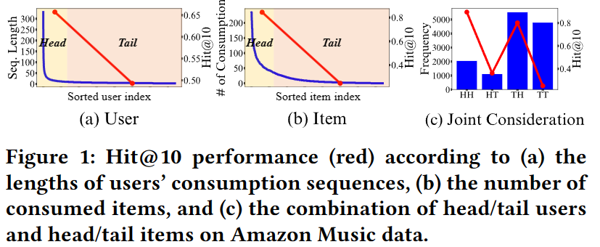
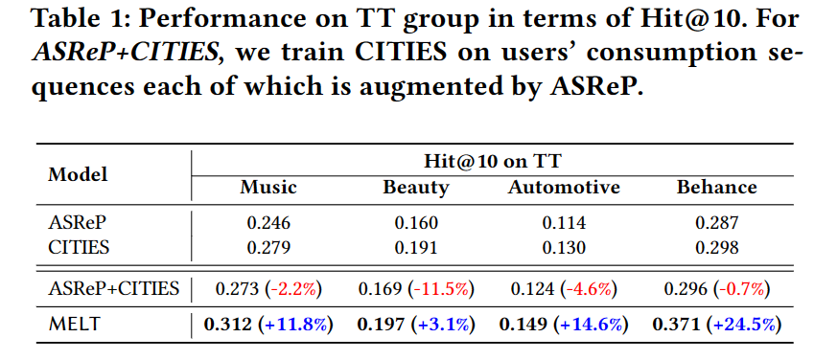
Motivation
Details：
While many existing studies address the long-tailed problem in SRS, they only focus on either the user or item perspective. However, we discover that the long-tailed user and item problems exist at the same time, and considering only either one of them leads to sub-optimal performance of the other one.

Slide 3
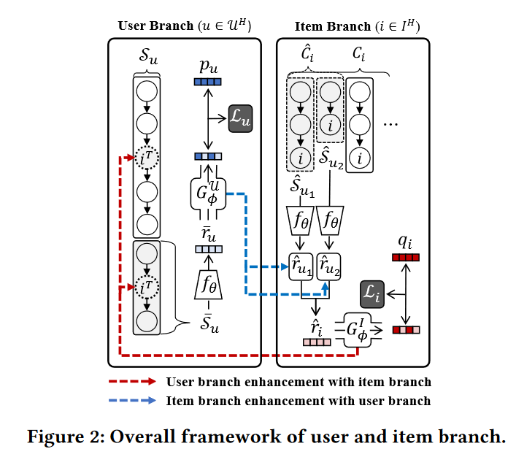
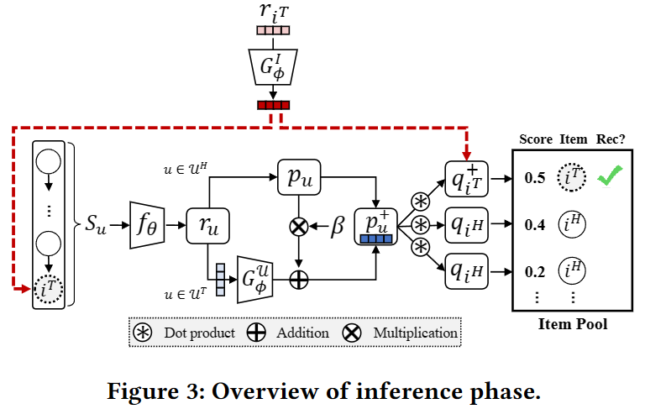
Problem Statement

Slide 4
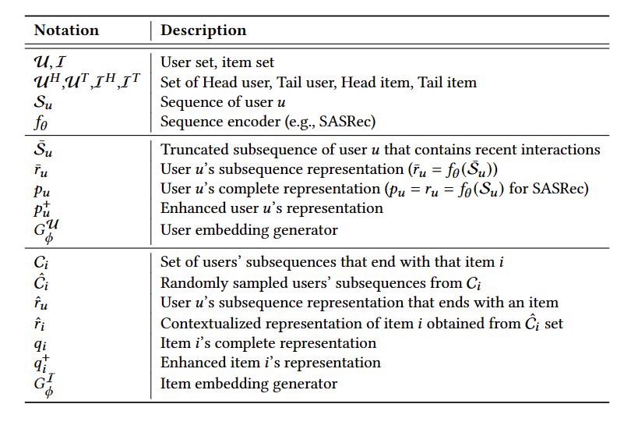
Problem Statement

Slide 5
Method

Slide 6
Method

Slide 7
Method

Slide 8
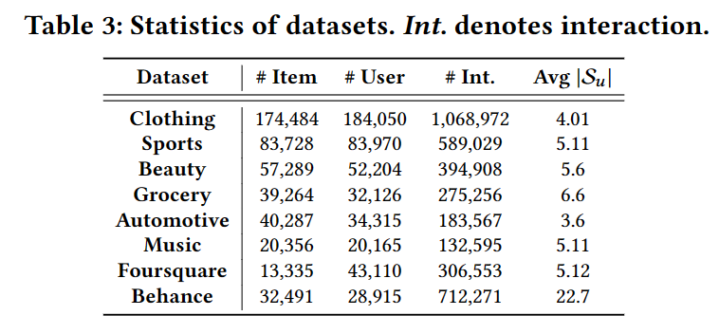
Experiments

Slide 9
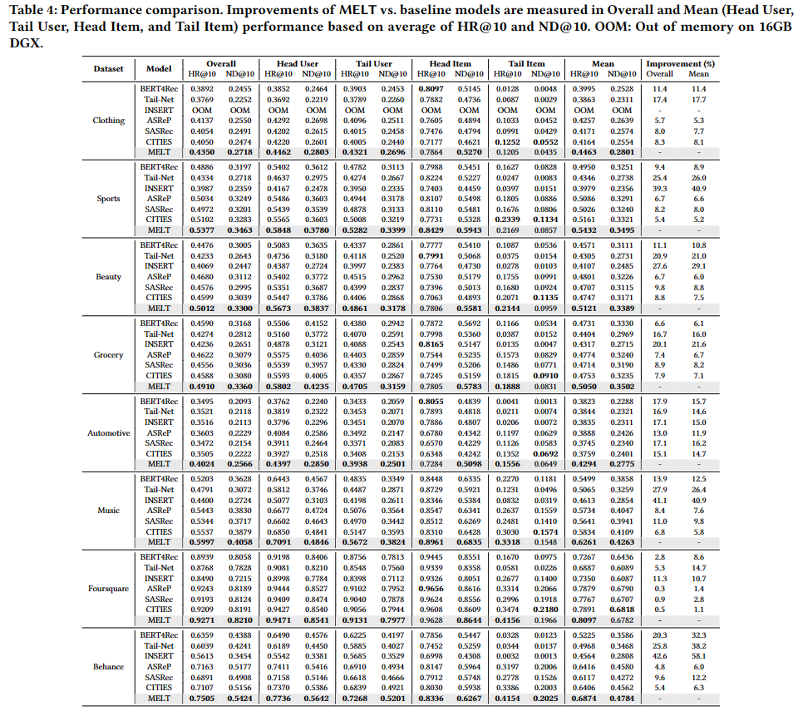
Experiments

Slide 10
Experiments

Slide 11
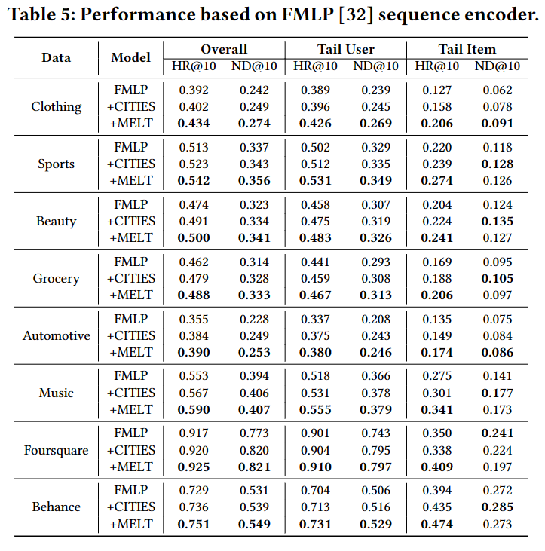
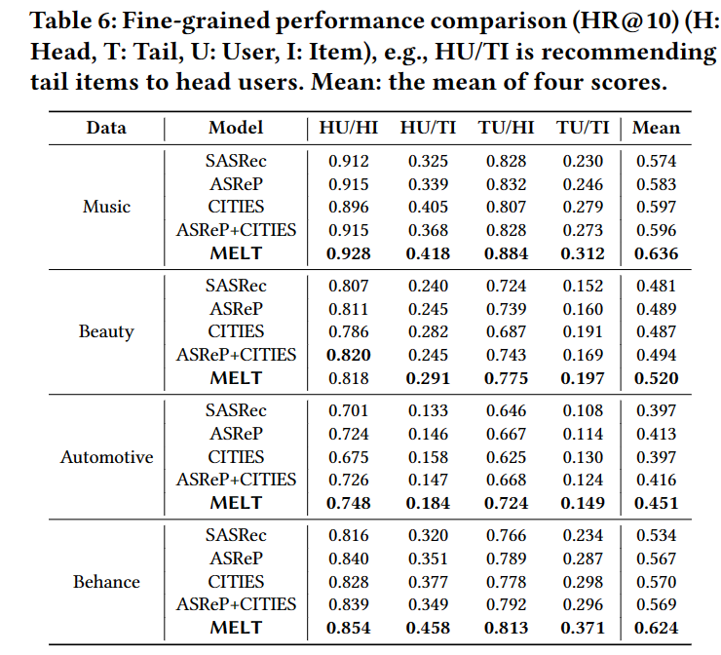
Experiments

Slide 12
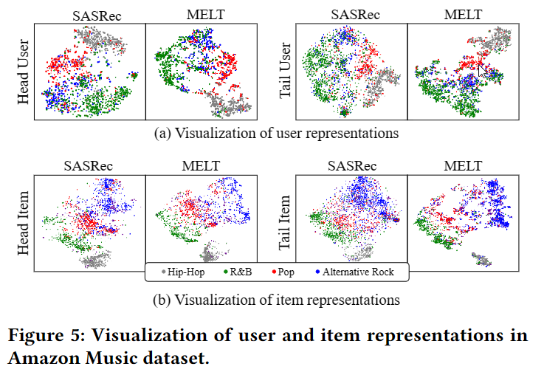
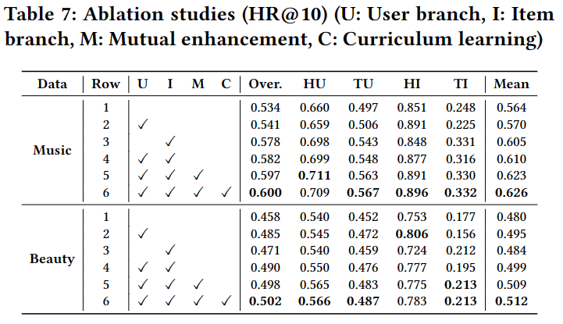
Experiments

Slide 13
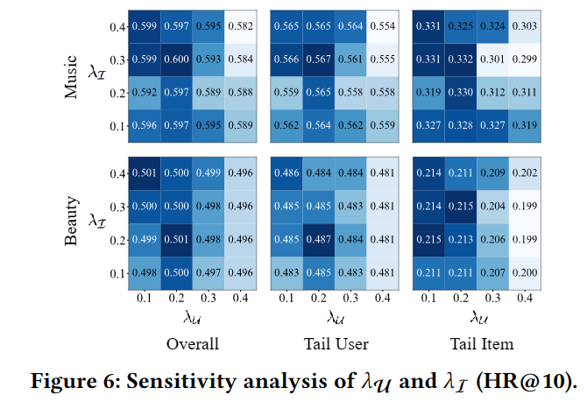
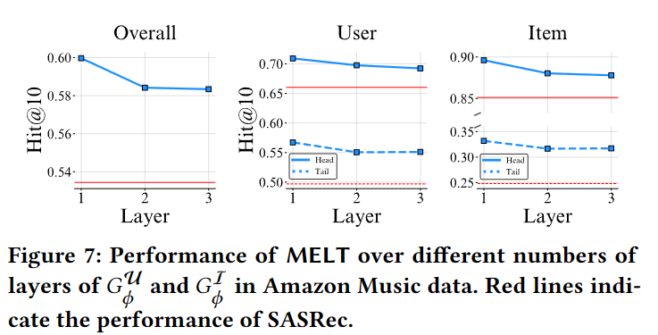
Experiments

Slide 14
Thanks

